Slide 1
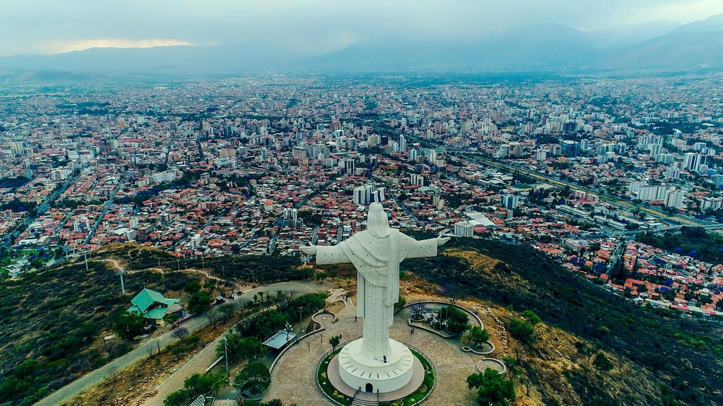
CityLab Catalyst
Cochabamba
Bolivia
By Nicola Caprirolo
Notes:
Hi, my name is Nicola Caprirolo and today I’ll be conducting a pecha kucha presentation for the Citylab Fieldwork on Cochabamba, with a focus on it’s Multiple Misicuni Project and water and sanitation system. Through interviews and analysis, we will dive deep into the historical, social, political and environmental contexts that shape this vital infrastructure project.

Slide 2
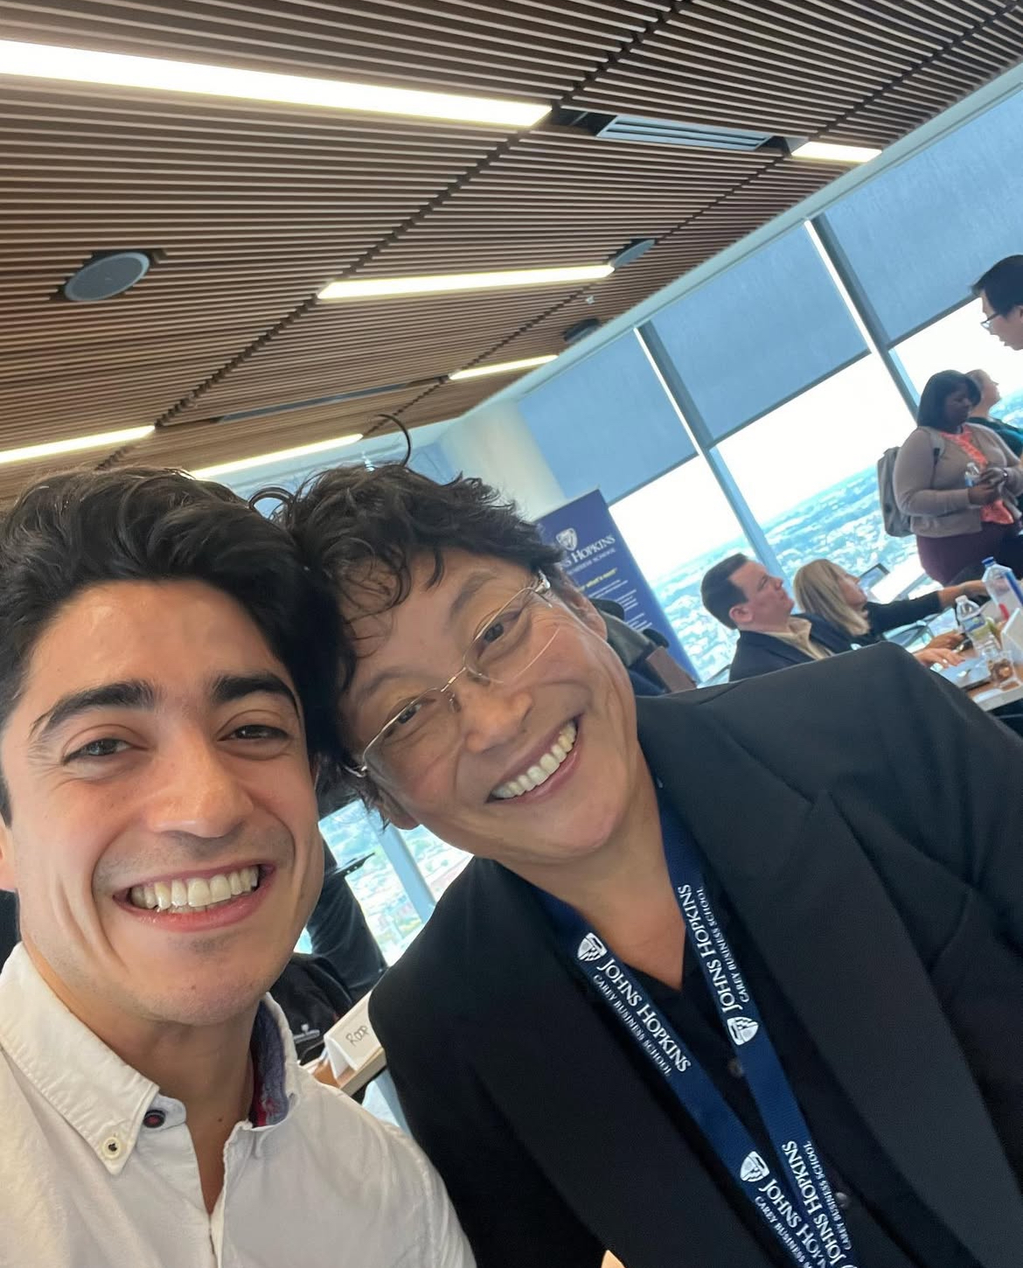
About Me
Father. God & Family 1st.
CEO & Founder - Holi Labs
Flex MBA Candidate at JHU
International Development, Cross-sectoral Cooperation, Sustainability, Blockchain, Healthcare
Half
Notes:
2.First some background on myself. I’m a proud dad and a man of faith before anything. I’m the CEO and Founder of Holi Labs, a decentralized protocol for holistic healthcare, and am a flex-MBA candidate at JHU. Most of my professional experiences involve intl. development and cross-sectoral cooperation to advance the UN SDGs, including irrigation and family agriculture projects at the FAO.

Slide 3
“City of Eternal Spring”- 17°C and 24°C.
Altitude ~ 2,500 mts.
2 MM Residents.
Water Scarcity & Inadequate Sanitation.
Notes:
3. Cochabamba is often referred to as the “City of Eternal Spring.”, were its citizens enjoy average temperatures between 17 and 24°C, with relatively low humidity. It’s at an altitude of approximately 2,500 meters above sea level.
It has over 2 million residents as of 2024.

Slide 4
Multiple Project Misicuni
Notes:
The Multiple Project Misicuni was designed to supply drinking water, irrigation, and hydroelectric power. Covering seven municipalities, it currently provides water to an estimated 400,000 residents. The project cost approximately $142 million, but has faced delays due to political and technical challenges.

Slide 5
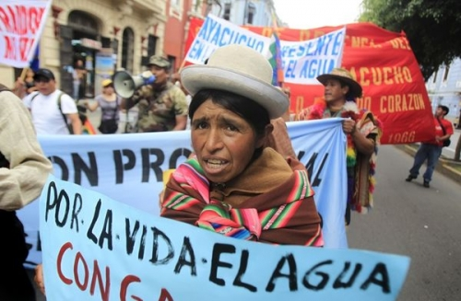
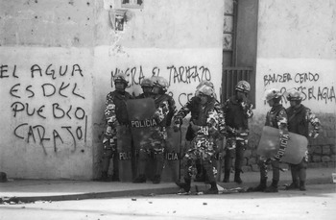
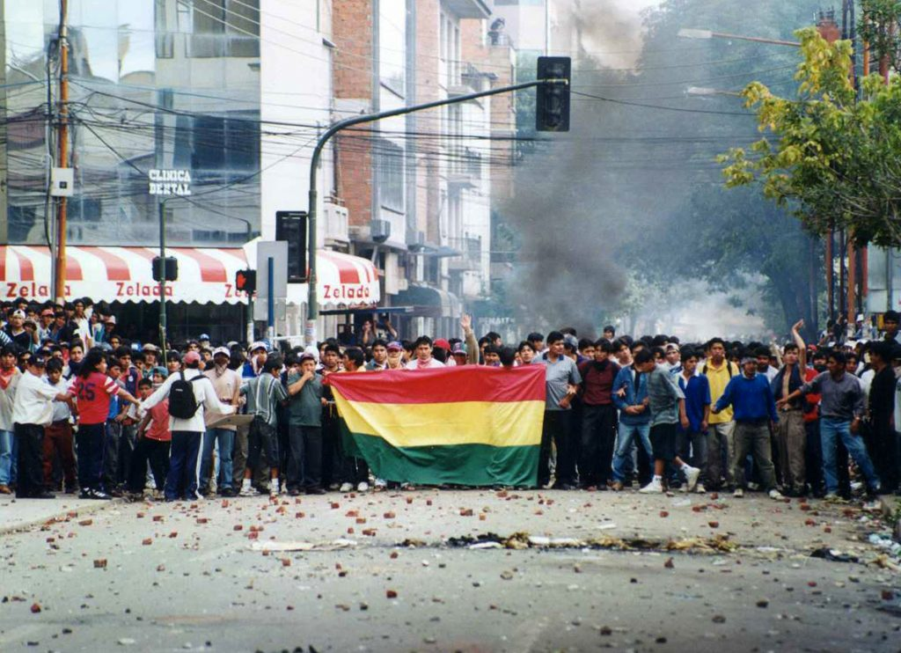
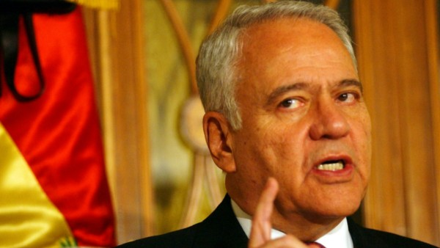
SEMAPA
(Municipal Water & Sewerage Service)
Notes:
Cochabamba has a complex history with water access. The Water War of 2000 symbolizes the deep-rooted accessibility issues of water and sanitation that persist today. The Misicuni Project was also unfortunately used as political leverage. The conflict was triggered by the privatization of SEMAPA, the Municipal Water and Sewerage Service, where it revealed inequalities in access to clean water.

Slide 6
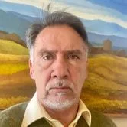
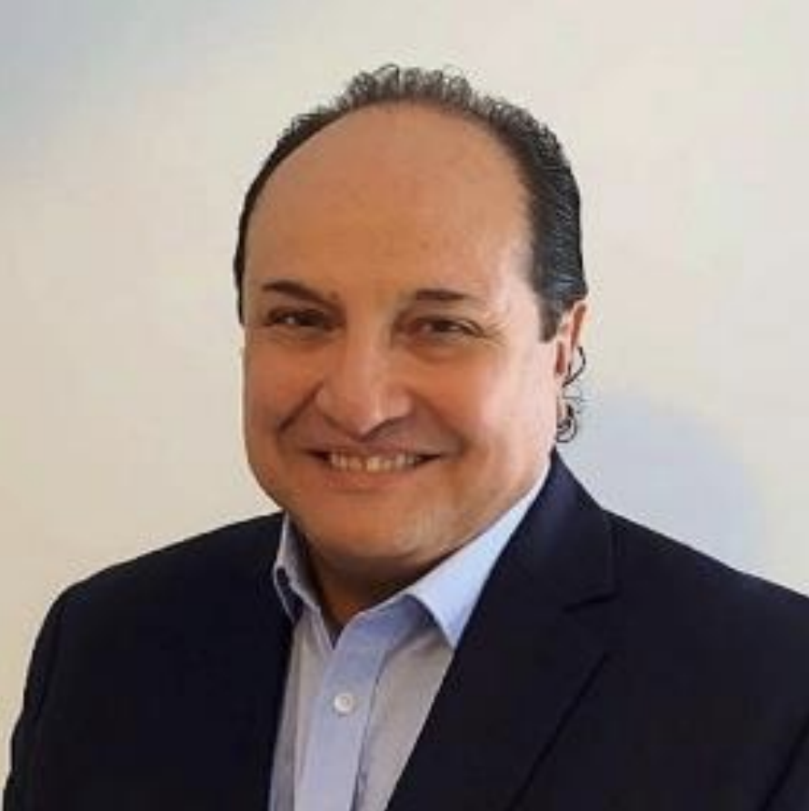
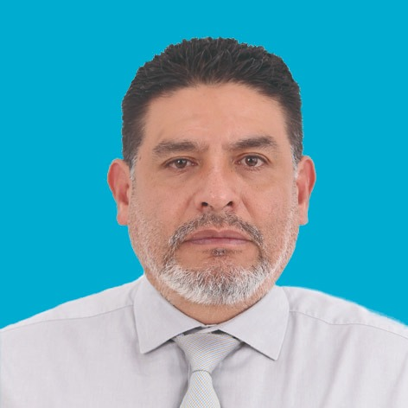
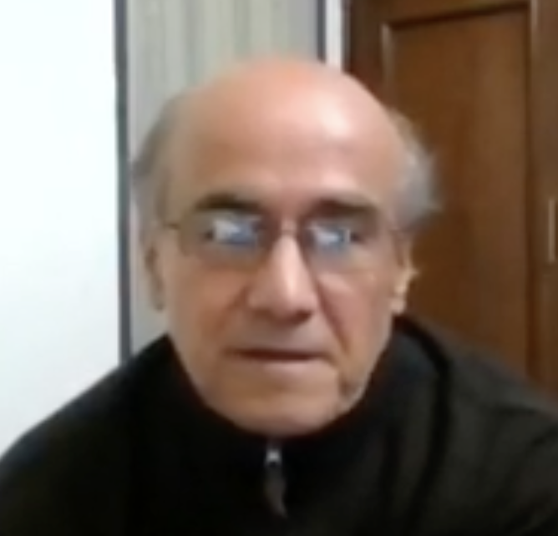
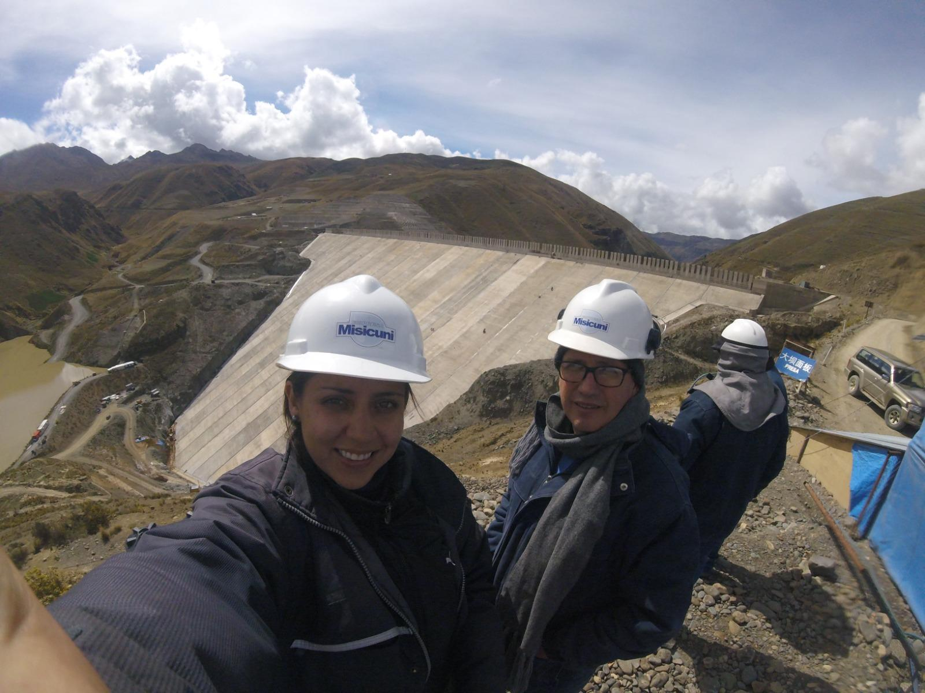
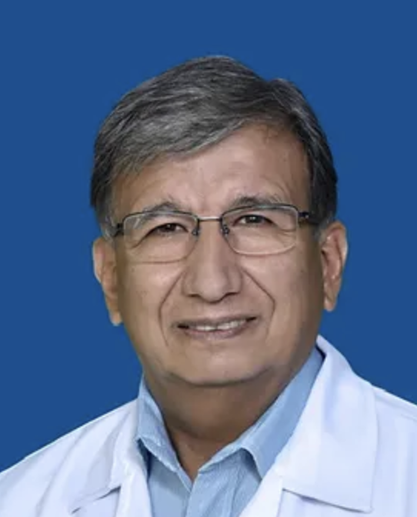
Key Stakeholder Interviews
Roberto Laserna
Economist, Urban Planner, Princeton Professor
Eng. Gustavo Méndez – Former General Manager of SEMAPA, Brazil Sector Lead and Southern Cone Countries Coordinator at the Inter-American Development Bank (IDB)
Mgtr. Luis Esteban
Prudencio Rodriguez
Current Executive General Manager of
Semapa
Eng. Pablo Lopez
Former Technical and General Manager of the Misicuni Project
Eng. Erika Estrada Loayza Civil Engineer, Former Assistant Engineer of the Misicuni Project
Eng. Juan Carlos Cabrerizo
Current Technical Manager of the Misicuni Project
Dr. Alberto Darras Healthcare Officer
Notes:
For my fieldwork I’ve cross-sectoral interviews to provide a broad understanding of Cochabamba’s water and sanitation system. This included independent, non-profit research and development organizations, a multilateral development bank, health experts, and direct stakeholders including SEMAPA and Misicuni ex and current affiliates.

Slide 7
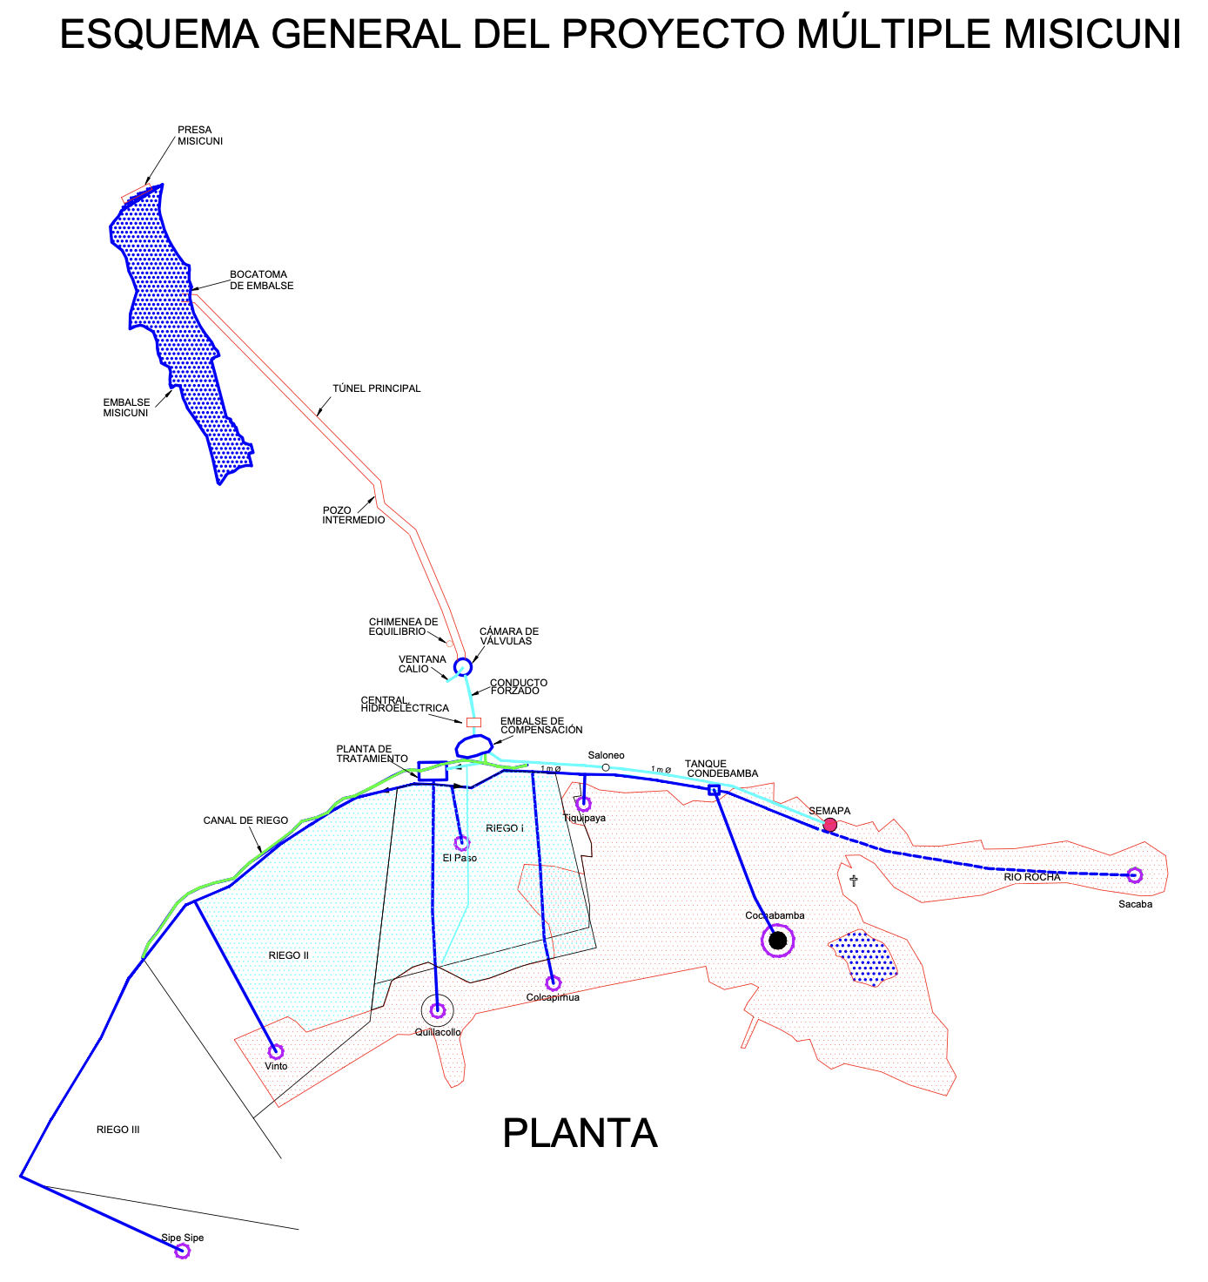
General Outline of the Multiple Misicuni Project
Notes:
Misicuni’s operations encompass three primary roles: irrigation, hydroelectric power generation, and potable water production. Stakeholders highlighted optimism for Misicuni but expressed concerns over its delayed implementation and coordination with local communities. Challenges in community trust, especially in marginalized areas, and technical inefficiencies were recurring themes.

Slide 8
Notes:
Cochabamba’s water infrastructure is fragmented and outdated, where most of it is still made out of concrete. Misicuni aims to improve access, but the challenge lies in integrating new systems with existing ones, where clandestine connections also complicate distribution.

Slide 9
Notes:
A lack of cohesive policy and vision between stakeholders has resulted in delayed efforts to streamline water distribution. UNICEF has reported that Bolivia has one of the highest rates of open defecation in Latin America, severely affecting health outcomes, especially for children.”

Slide 10
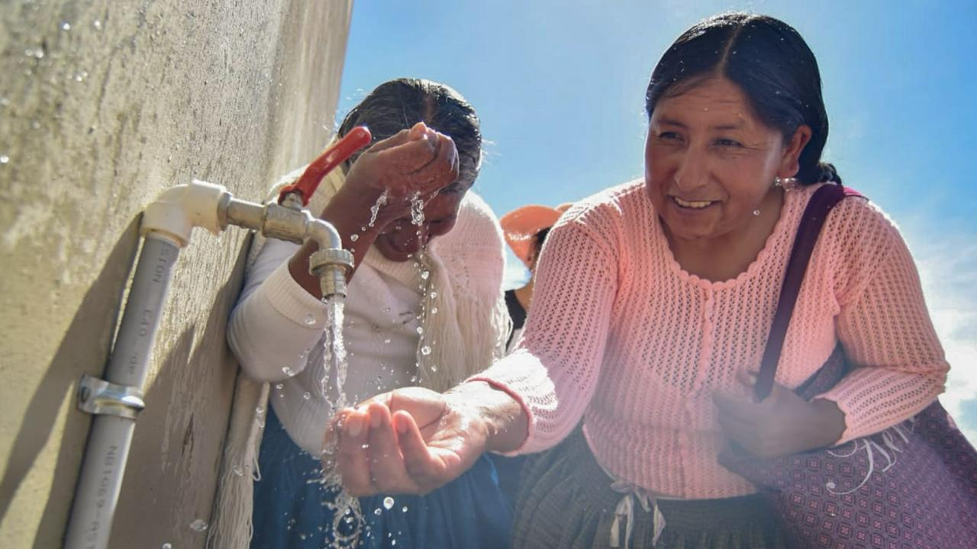
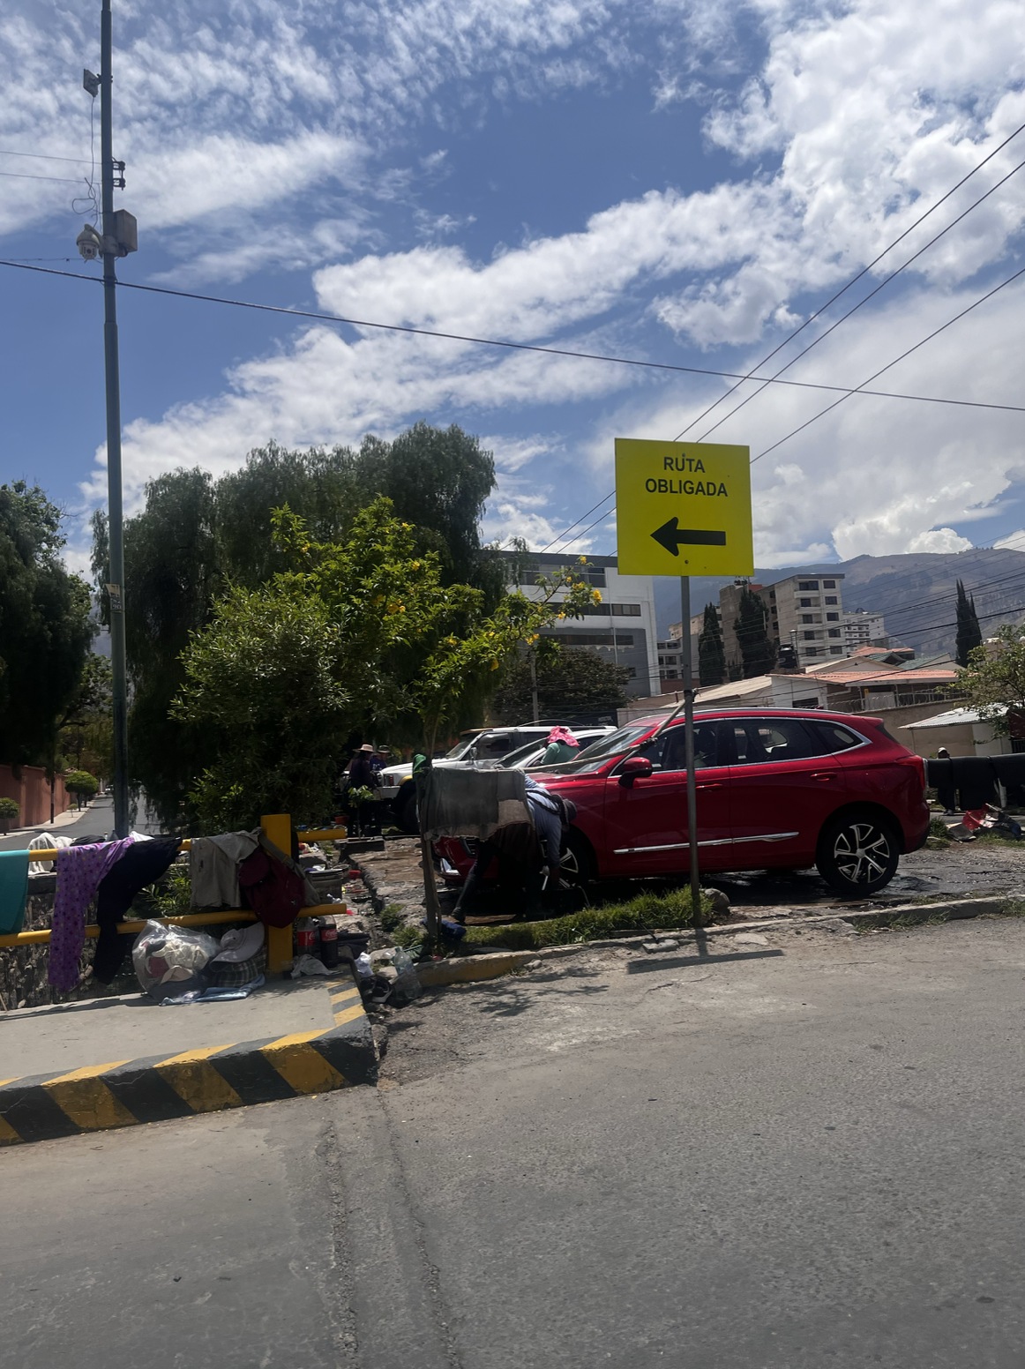
Notes:
Bolivia still faces significant challenges in combating misinformation and educational barriers. Education campaigns and community awareness programs are critical to overcoming these hurdles. The photo on the right depicts a group of people using the water from a river to clean cars and clothes. I came to learn that they weren’t just working, they were there because it’s part of how they spend time with their community.

Slide 11
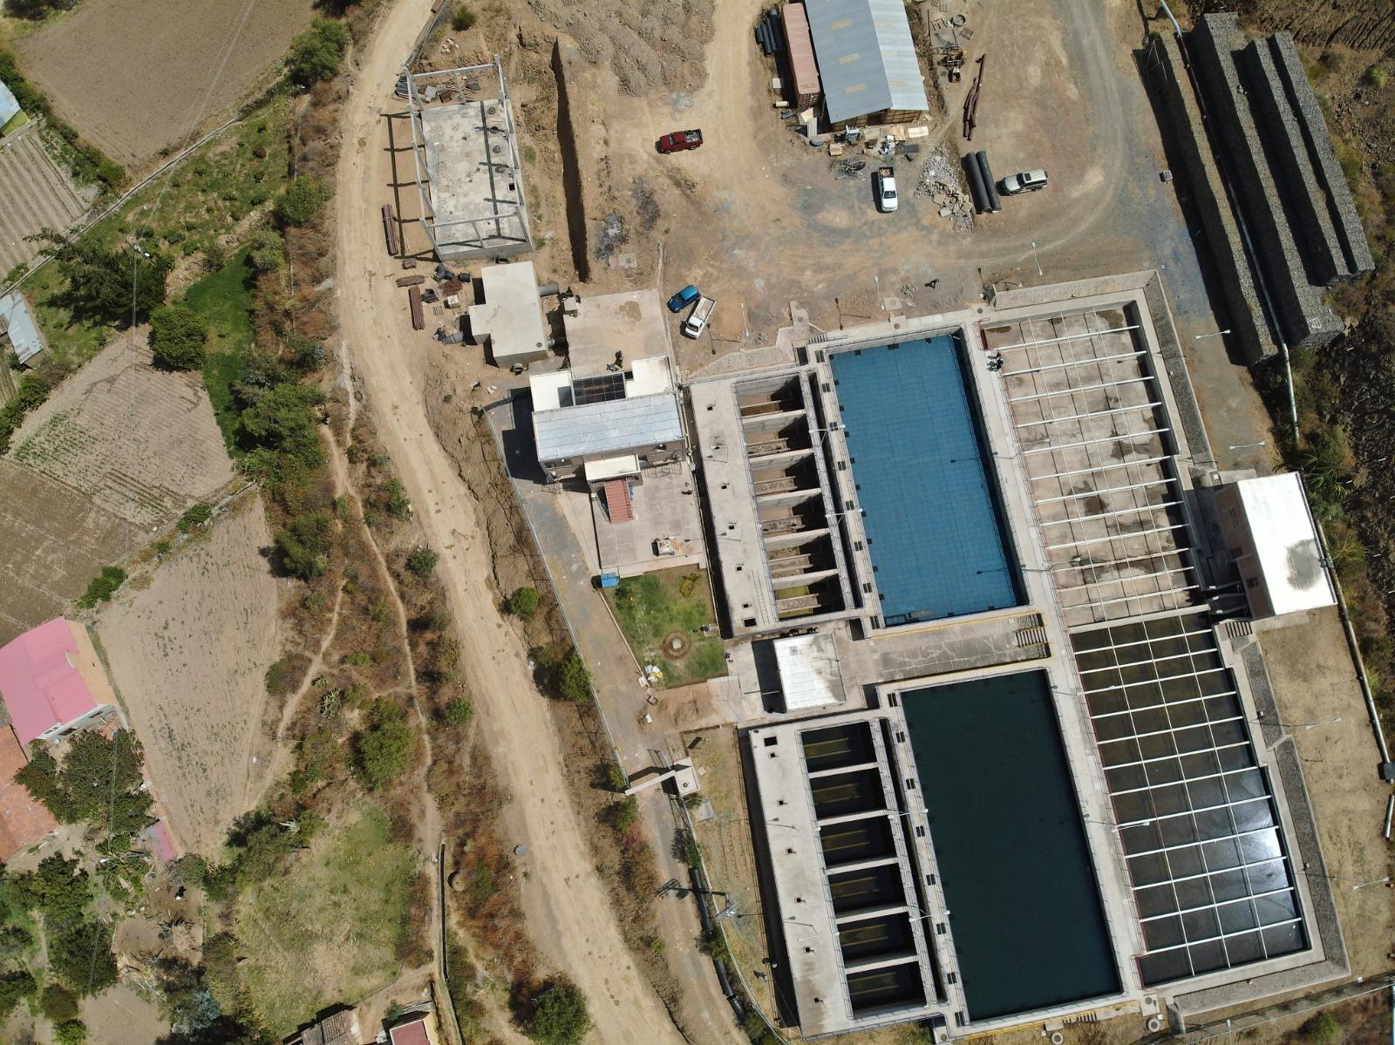
Notes:
Cochabamba’s water treatment projects aim to address the city’s sanitation issues. These facilities ensure safe drinking water and improve public health outcomes.

Slide 12
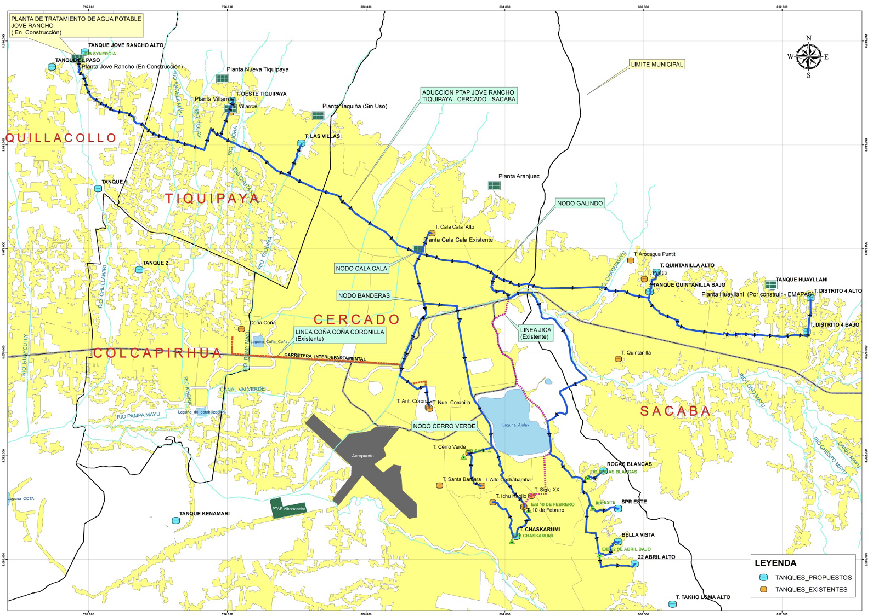
SOUTH SIDE
Notes:
In southern districts, water shortages are a daily struggle. Many residents rely on private vendors, paying higher prices for lower-quality water. This is mainly due to cultural preferences to stay disconnected to the city’s main water system, viewing SEMAPA as an extractive entity. Despite this, Bolivia’s under-five mortality rate remains high, with waterborne diseases contributing significantly to the issue.

Slide 13
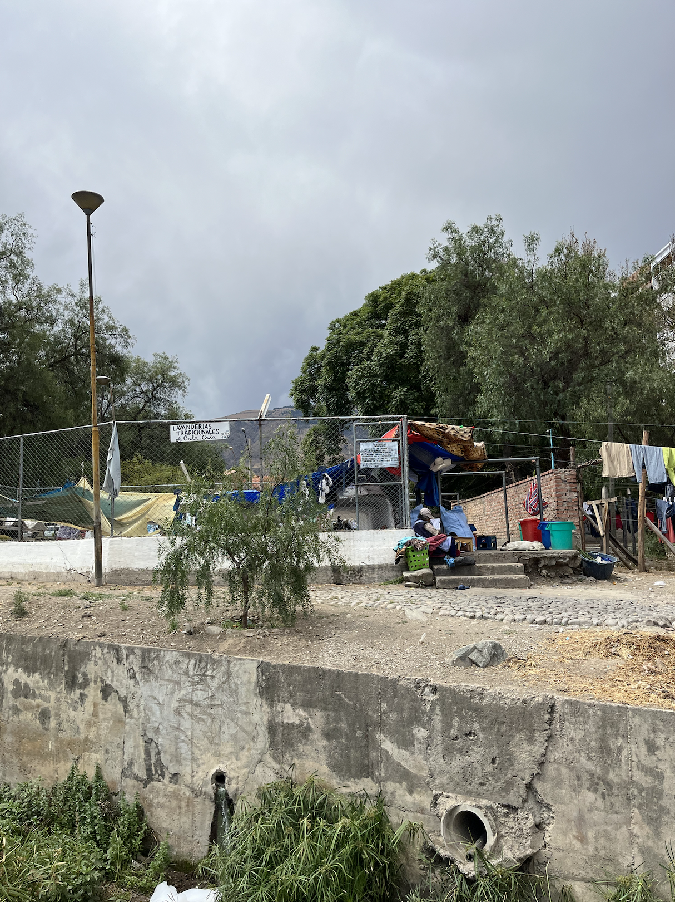
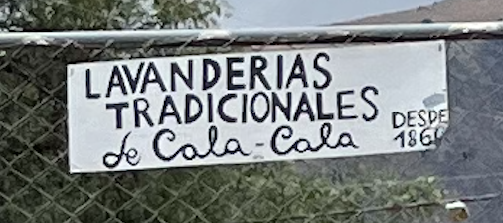
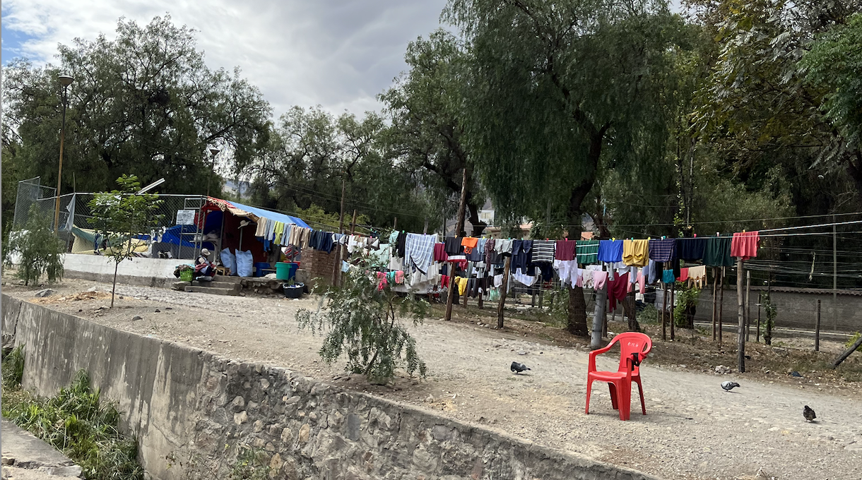
Notes:
With Traditional laundries dating back to 1866, the city’s infrastructure demonstrates a societal desire to stick to traditional ways of life. Historically, these laundries have been a significant cultural symbol, where residents, particularly women, gathered to wash clothes using natural water that flowed through the city. The Cala Cala laundries are not just utilitarian spaces but also social hubs where community members exchanged stories, advice, and maintain social bonds.

Slide 14
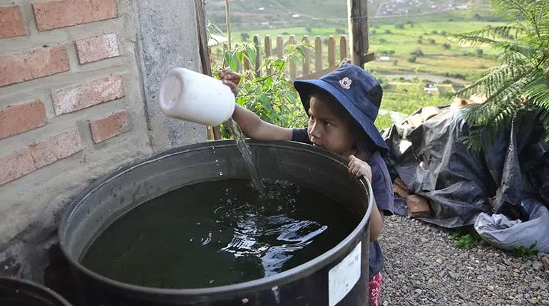
Notes:
Many parts of Cochabamba still rely on cistern and tank systems to store water. This outdated system presents significant limitations and inefficiencies, further complicating efforts by SEMAPA and Misicuni to deliver consistent water services. The use of cisterns highlights the need for integrating circular economy principles in water management to reduce waste and improve sustainability.

Slide 15
Management Models: Types of OLPES
Tipo de OLPES | Cercado | Colcap. | Quillac. | Sacaba | Sipe Sipe | Tiquip. | Vinto | Totales | %
Territorial Base Organizations | 23 | 15 | 28 | 46 | 1 | 9 | 11 | 133 | 21.49%
Self-managed Systems | 122 | 48 | 75 | 52 | 18 | 35 | 13 | 359 | 58%
Coop. | 11 | 9 | 4 | 12 | 1 | 3 | 0 | 40 | 6.46%
Private Urban Systems | 26 | 13 | 10 | 14 | 0 | 3 | 1 | 67 | 10.82%
Agrarian Unions | 7 | 0 | 1 | 7 | 0 | 1 | 0 | 16 | 2.58%
TOTAL EPSAS | 189 | 85 | 118 | 131 | 20 | 51 | 25 | 619 | 100%
Notes:
Local community organizations, such as OLPES, which are Local Water and Sanitation Service Provider Organizations, have launched much needed initiatives to improve water management at a grassroots level, a model that is preferred by a considerable segment of the population as shown in the far right hand column. These projects empower local populations, but face challenges in scaling and integrating with city-wide infrastructure.
EPSAS: Public Water and Sanitation Service Entities

Slide 16
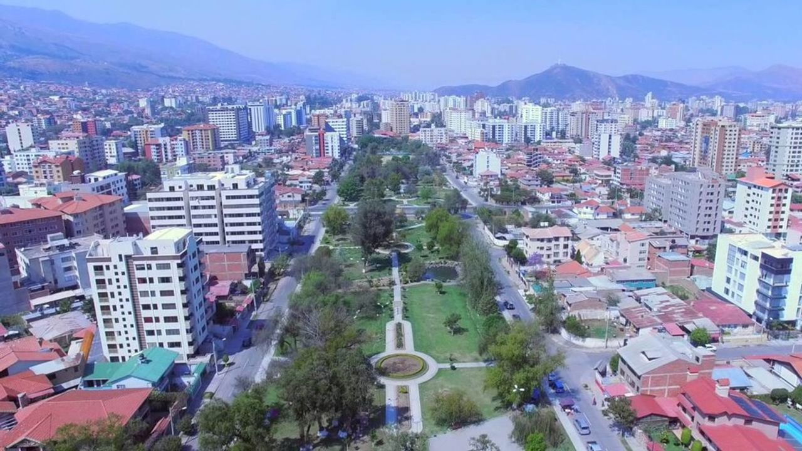
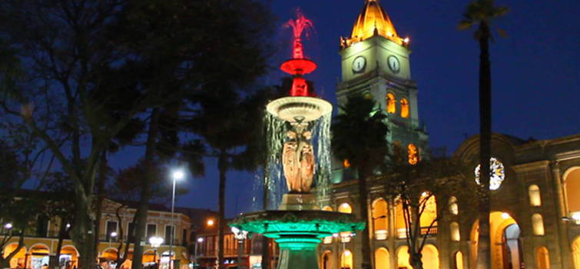
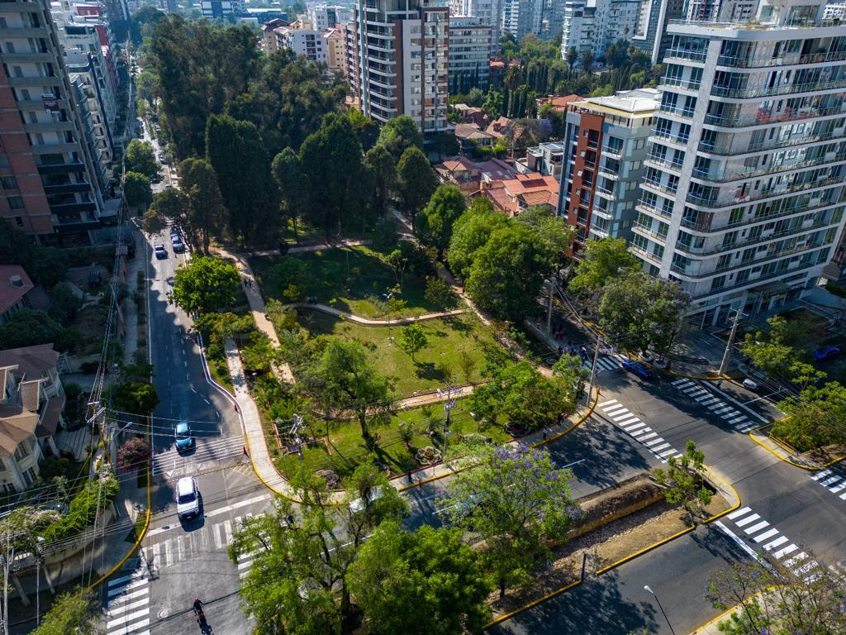
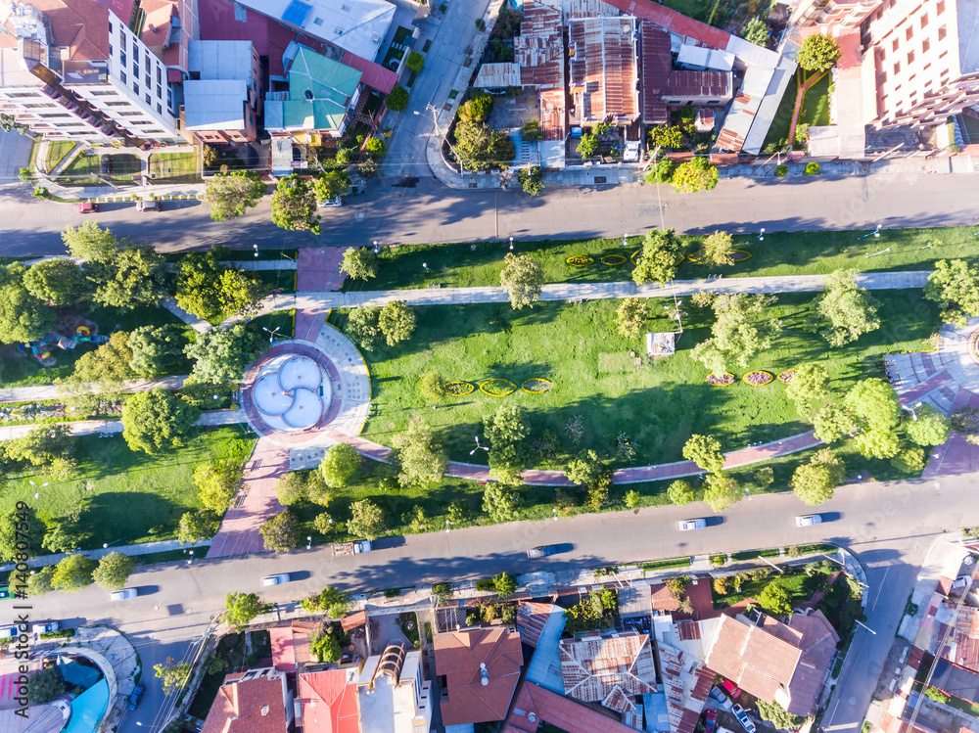
Notes:
SEMAPA envisions transforming Cochabamba’s water landscape by integrating sustainable water systems into urban planning. Their aim is to create green spaces, enhance public health, and provide equitable access to water for all residents. After conducting my fieldwork, it appears they are the ones best positioned to do so across Cochabamba.

Slide 17
Notes:
The future of Cochabamba’s water supply relies on continued investment and expansion of the Misicuni Project. A viable plan discussed by some engineers was to source water from Corani, where it would also connect to two nearby rivers. This could expand the city’s water reserves in time, safeguarding its sustainability for decades to come.”

Slide 18
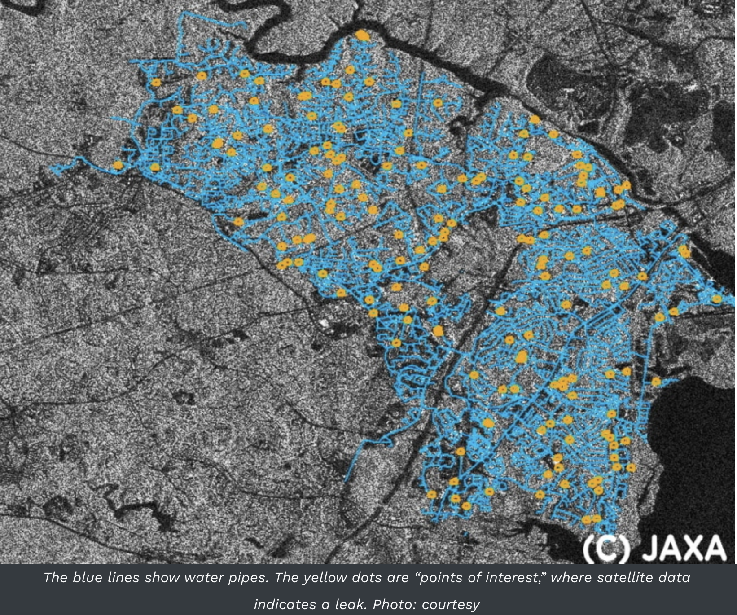
Notes:
Cochabamba must urgently prioritize the progressive modernization of it’s underground water infrastructure. To do so, I am in the process of introducing Semapa’s general manager to Asterra, an Israeli start-up that detects pipeline leaks from outer space. Their advanced AI system is capable of identifying leaks by detecting chlorine traces and temperature differences from space. With Cochabamba losing up to 40% of its water due to leaks, this technology could exponentially minimize its water loss and improve its infrastructure efficiency.
This

Slide 19
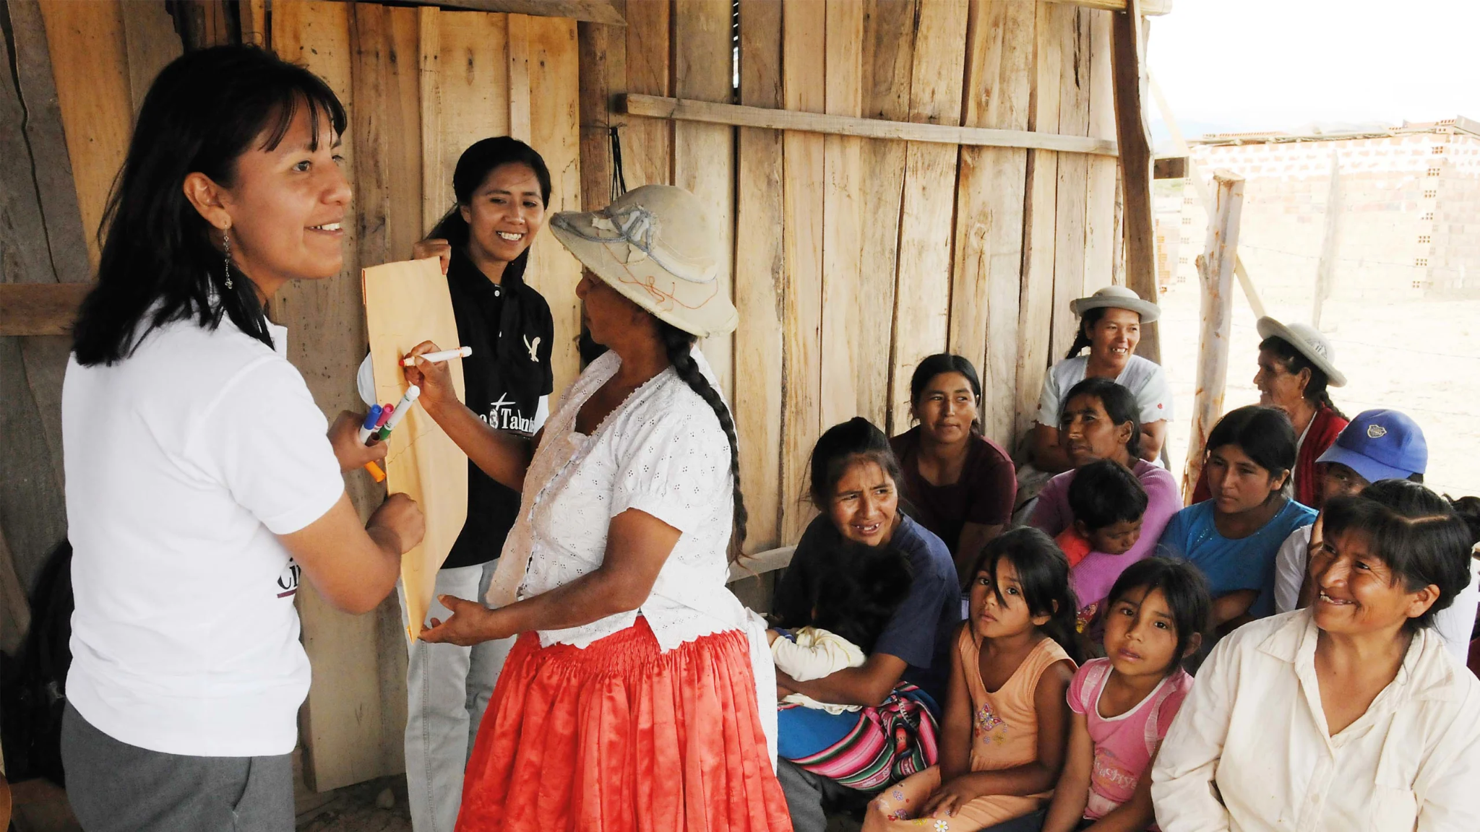
Notes:
To work on reducing Cochabamba’s infant mortality rate, it will need to implement a large-scale public campaign to promote water conservation and sanitation awareness. Many community leaders, such as Luis Prudencio, SEMAPA’s General Manager, emphasize the importance of educating the public on sustainable water use. By partnering with local schools, NGOs, and media outlets, SEMAPA could foster a culture of water consciousness, especially in the southern district, where water shortages are most acute.

Slide 20
Notes:
Cochabamba’s future hinges on a collective effort to manage its most precious resource. The Misicuni Project now symbolizes hope for the city. Nonetheless, for Misicuni to truly transform Cochabamba, it requires active collaboration between community leaders, government agencies, and international partners. Only by investing in urban design that’s representative of each municipality, embracing innovative technologies like satellite monitoring, and fostering cross-sectoral engagement, can Cochabamba secure a sustainable and equitable future for all its residents.

Slide 21
References
Aurora Israel. (2022, October 11). Asterra, the Israeli start-up that detects pipeline leaks from outer space. https://aurora-israel.co.il/en/Satellites-detect-leaks-in-water-pipes-from-high-above-the-earth/
Instituto Nacional de Estadística Bolivia. (2024). INE culmina socialización del conteo poblacional del censo 2024 y convoca a mesa técnica nacional. Retrieved from https://censo.ine.gob.bo
Olivera, O., & Lewis, T. (2004). Cochabamba! Water war in Bolivia. South End Press. Retrieved from https://www.researchgate.net/publication/260324071_Cochabamba_Water_War_in_Bolivia_by_Oscar_Olivera_Tom_Lewis
Misicuni Project Report. (2017). Proyecto múltiple Misicuni: Reporte técnico de infraestructura y distribución de agua. Gobierno Autónomo de Cochabamba. Retrieved from https://www.misicuni.gob.bo/download/informe-de-gestion-2017/
SEMAPA Annual Report. (2022). Informe de gestión del servicio de agua potable y saneamiento de Cochabamba. SEMAPA. Retrieved from https://semapa.gob.bo/resources/plugins/tiny_mce/plugins/filemanager/source/transparencia/InformeFinal2022.pdf
Misicuni Project Report. (2019). Redes de distribución de agua potable: Proyecto Misicuni. Gobierno Autónomo de Cochabamba.

Slide 22
References
Prudencio, L. (2024, October 6). Entrevista con el Gerente de SEMAPA: Perspectivas y desafíos del agua en Cochabamba. In-person interview.
CityLab Interviews. (2024). Entrevista con María Teresa Darras y Alberto Darras sobre el acceso al agua en Zona Sur. In-person interview.
SEMAPA Technical Report. (2023). Reporte técnico sobre las pérdidas de agua en la red de Cochabamba. SEMAPA.
CityLab Interviews. (2024). Entrevista con Gustavo Mendez sobre la visión de SEMAPA y el proyecto Misicuni. Virtual interview, September 13, 2024
Prudencio, L. (2024, October 6). Entrevista con el Gerente de SEMAPA sobre la educación comunitaria y conservación de agua. In-person interview.
Misicuni Project Report. (2023). Evaluación de la sostenibilidad ambiental del proyecto Misicuni. Gobierno Autónomo de Cochabamba.
CityLab Interviews. (2024). Entrevista con Pablo Lopez sobre las plantas de tratamiento de aguas residuales en Cochabamba. Virtual interview, September 19, 2024.

